Slide 1
Sales Dashboard & Forecasting Presentation Using Power BI & Tableau
Objective → This Presentation will help to understand, use, visualize, & interact with the dashboard & give basic Knowledge about it.
What is Dashboard?
Dashboard is a visual interface to analyze and understand your data easily.
Helps in tracking Key Performance Index, trends, customer activity, etc.
How to Open & Use it ?
Provided Dashboard are in two formats – .pbix & .twbx
.pbix format file is PowerBI Dashboard & can open from PowerBI.
.twbx format file is Tableau Dashboard & can open from Tableau.
Both tools can show Real Time Data on Website.

Slide 2
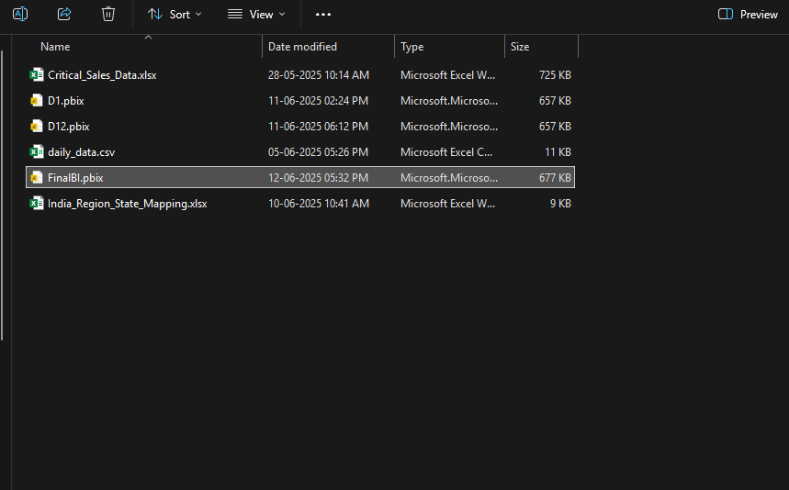
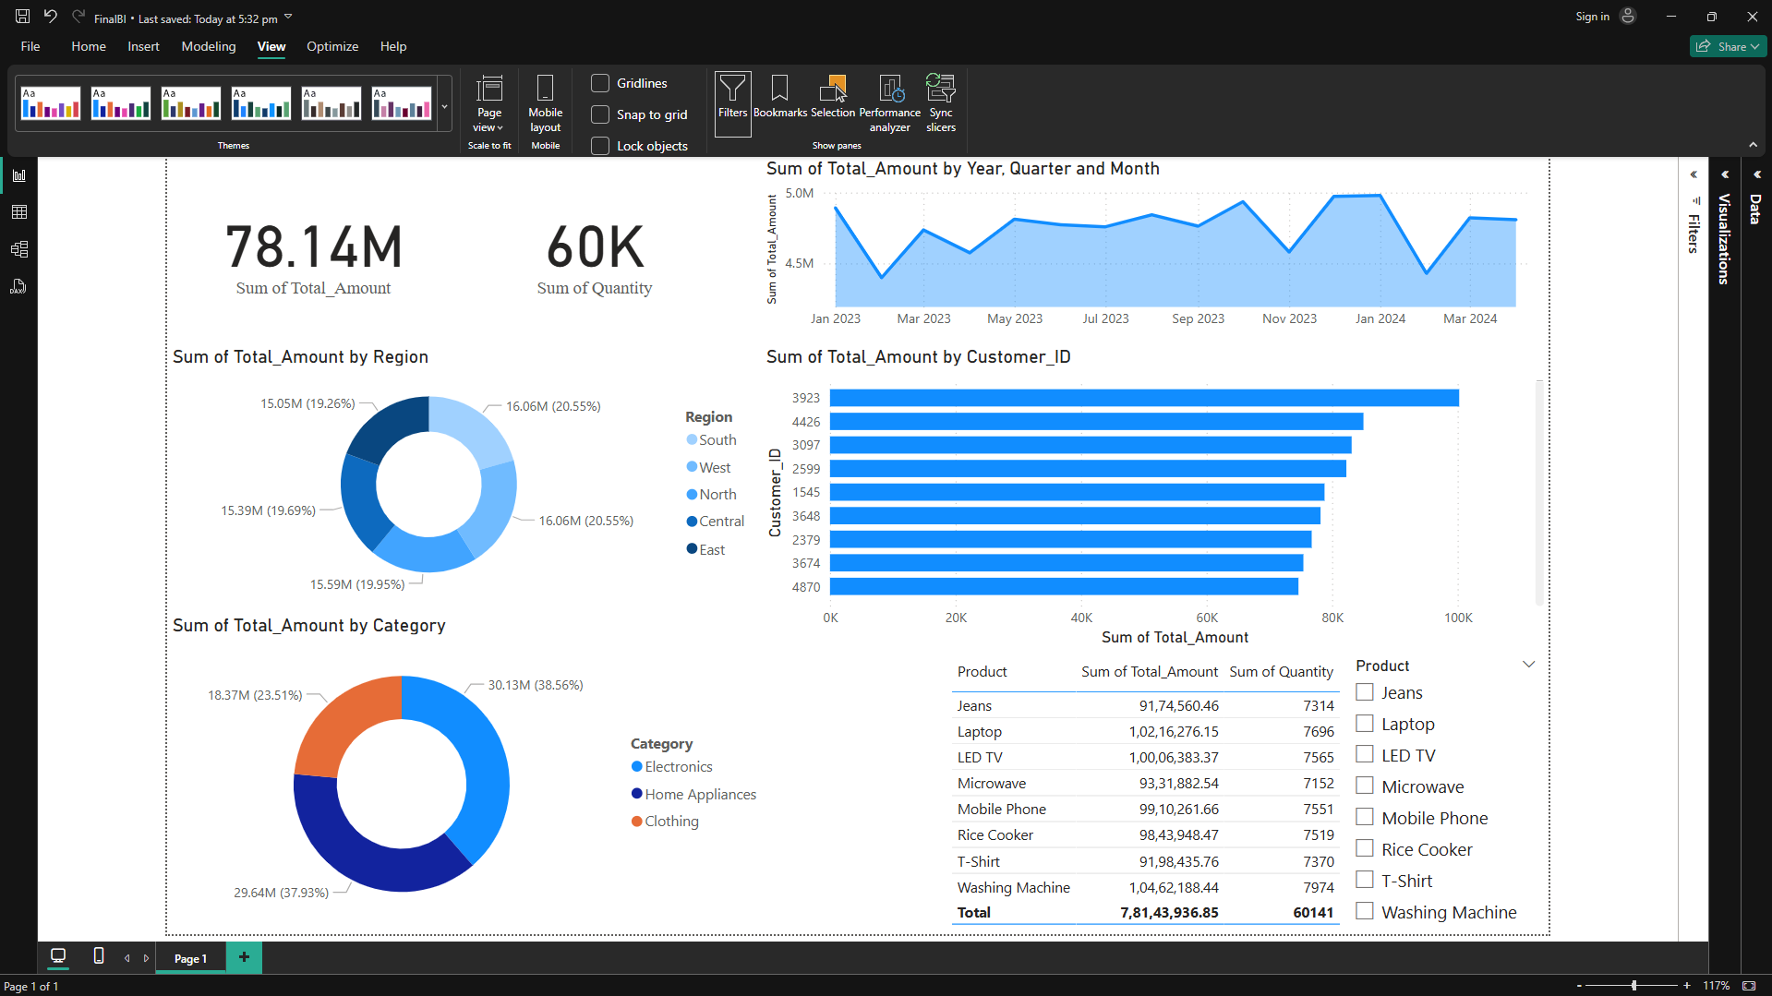
Power BI:
Download PowerBI from the Microsoft PowerBI Website or from Microsoft Store.
You can open .pbix file in Power BI Desktop (free).
Or publish & view online in Power BI Service (need work account)
STEPS : Just Double click on the .pbix file after Installing PowerBI to view in the tool.

Slide 3
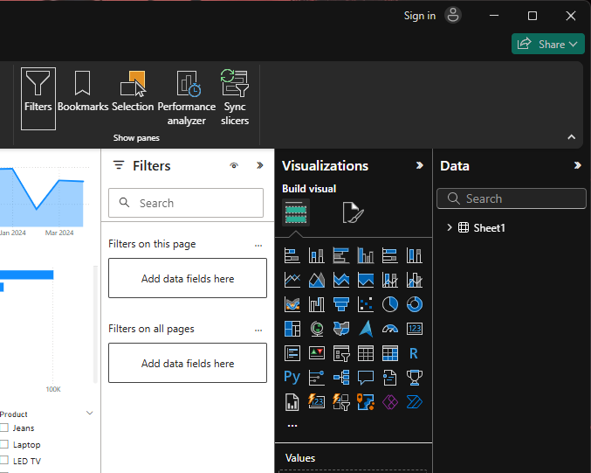
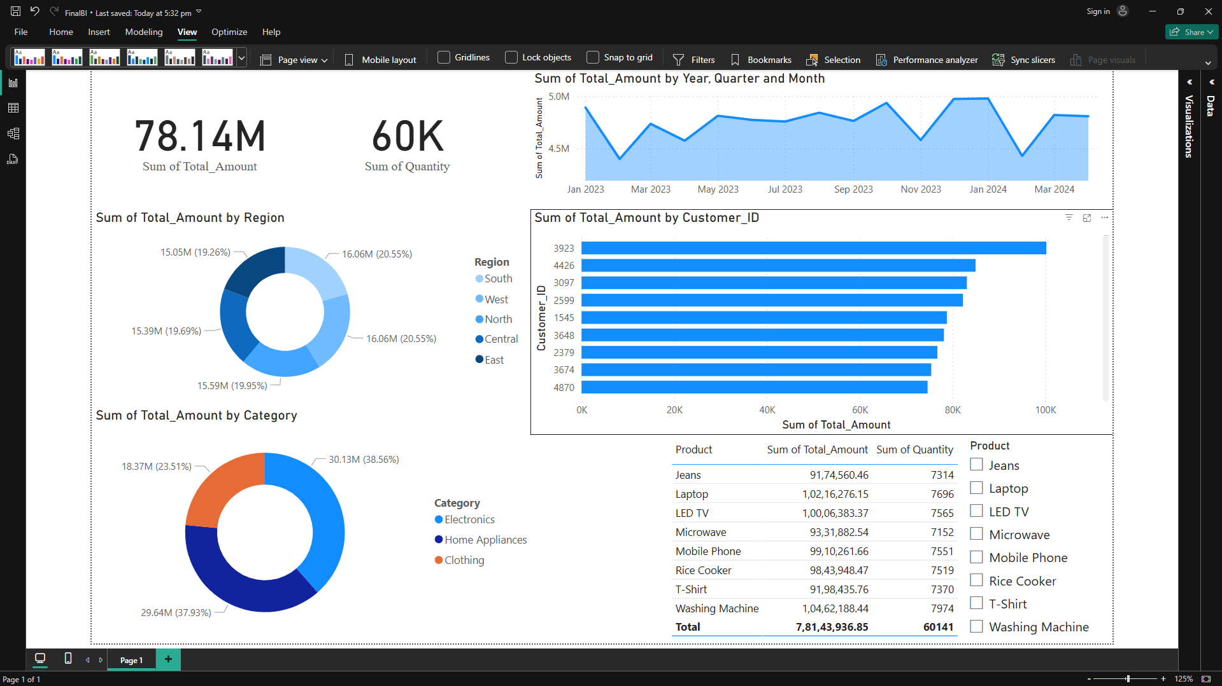
Collapse the Filters, Visualization, Data tabs for better view in PowerBI desktop by clicking on the arrow’s.
Data PowerBI does not contain any presentation mode so this will help to get better view.

Slide 4
Total Units Sold = sum of all category units sold
Total Revenue Generated = Clothing Revenue + Home Appliance Revenue + Electronics Revenue
Top Customer.
Understanding the Elements of Dashboard.
Revenue & Units sold , Product Wise
Revenue Generated Category wise.
Revenue Generated per region
Revenue Timeline by Month = Total revenue Generated per month
Notes:
Total amount generated

Slide 5
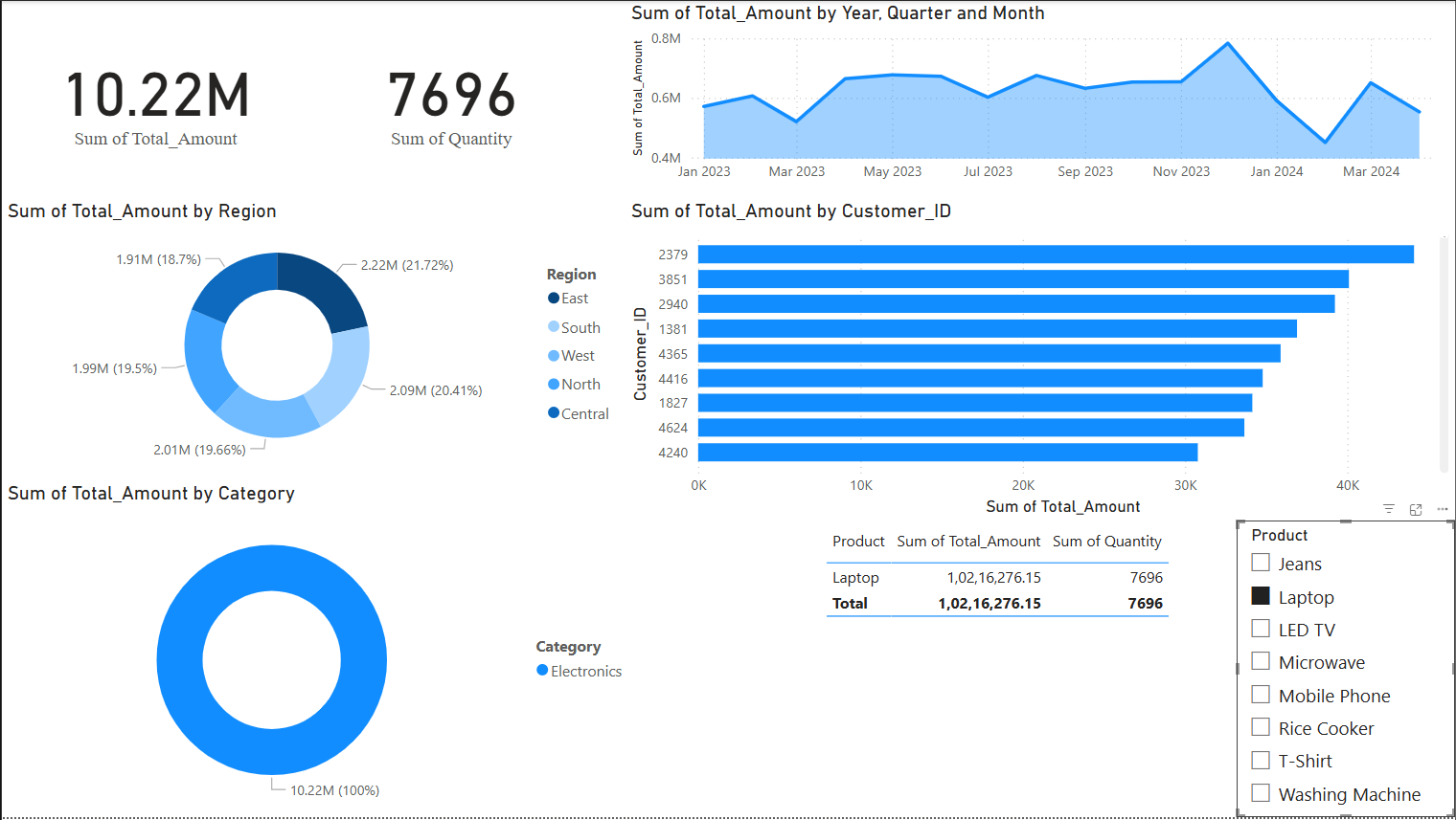
Interaction with Dashboard
Selected Product Sales as per region
Selected Product Revenue Performance by Month
It will filter all the visuals according to the product performance.
You can Interact with dashboard to get a specific visual from a category as per requirement.
Product Contribution in Category.
Top customer as per Selected Product

Slide 6
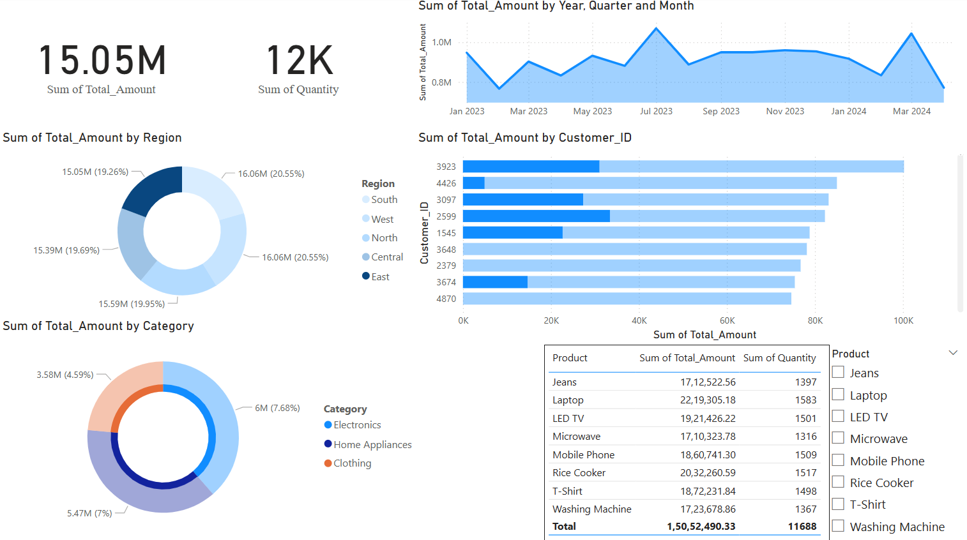
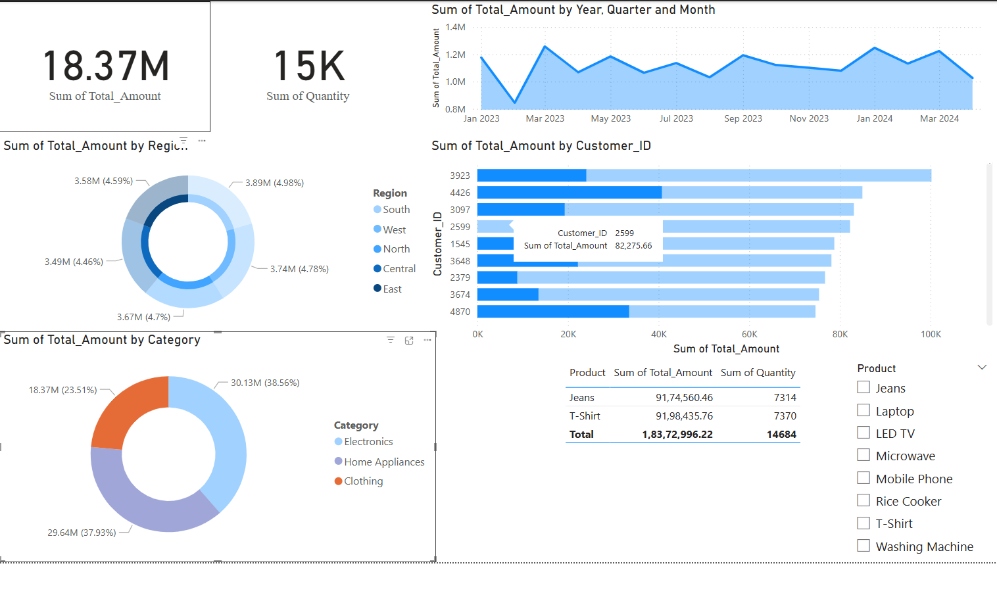
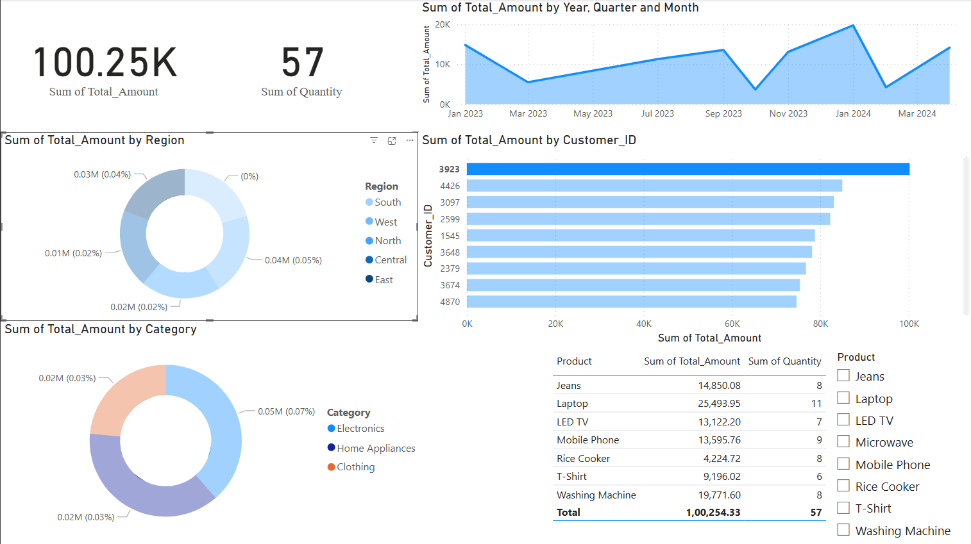
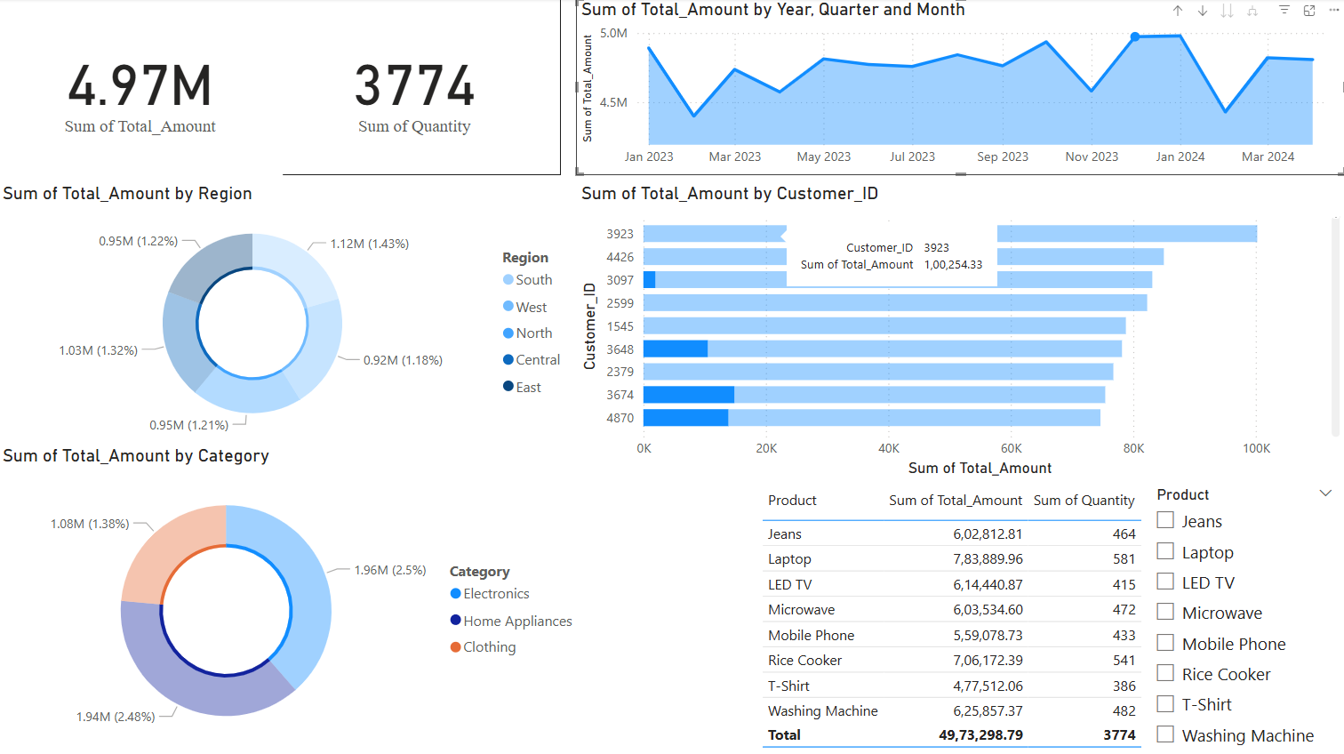
Performance By Month
Visuals as per Customer
Visuals as per Region
Visuals As per Product Category.

Slide 7
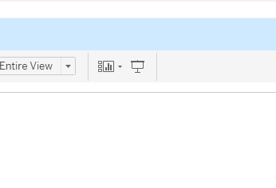
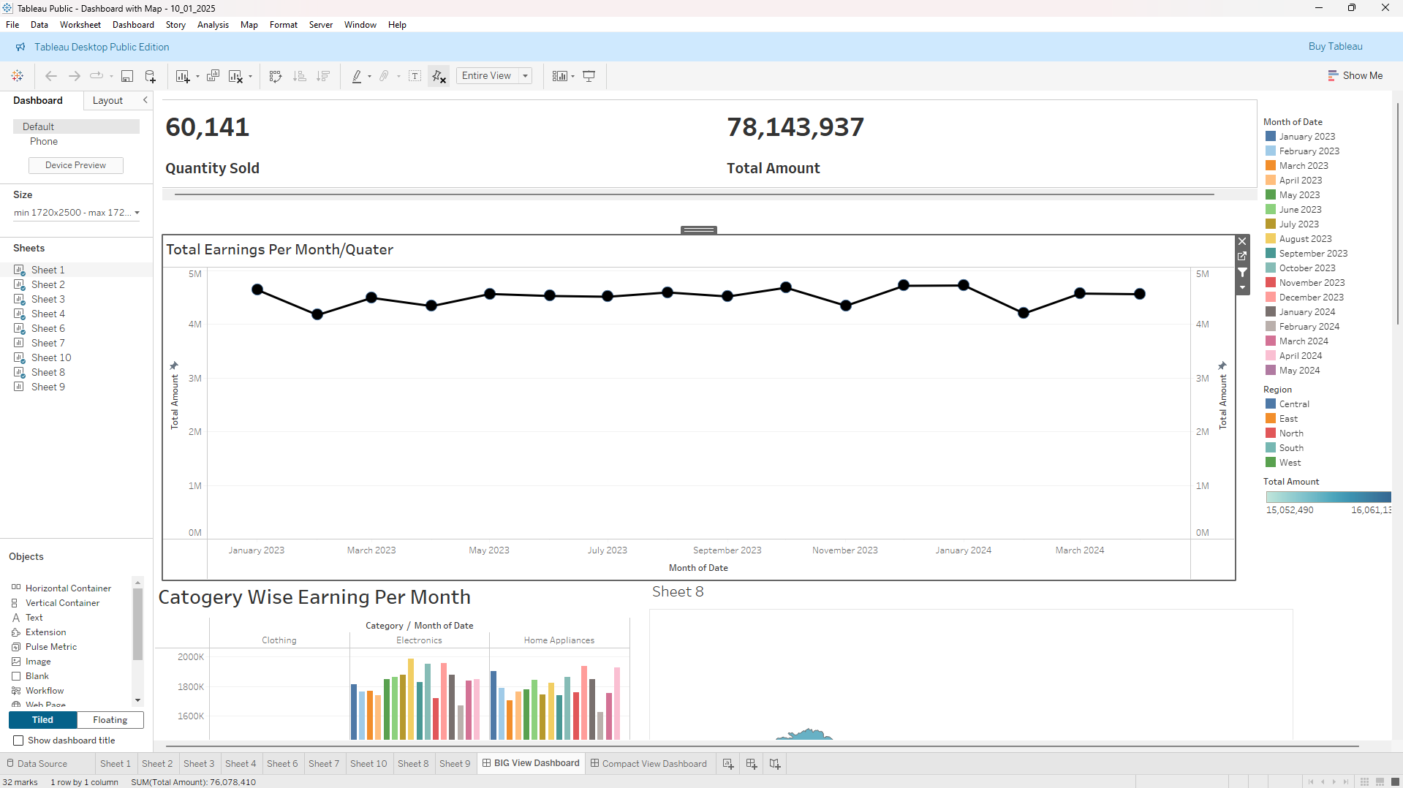
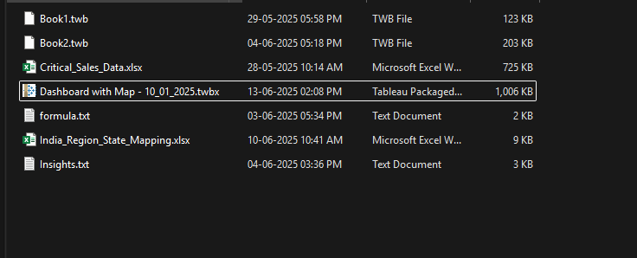
Tableau:
Open .twbx file in Tableau Public Desktop in presentation mode ( free ), but need license for Tableau Private.
Or view online using Tableau Public ( free ) / Tableau Server ( need to purchase )
STEPS : Just Double click on the .twbx file after Installing Tableau & open Presentation mode ( Press F7 ) .

Slide 8
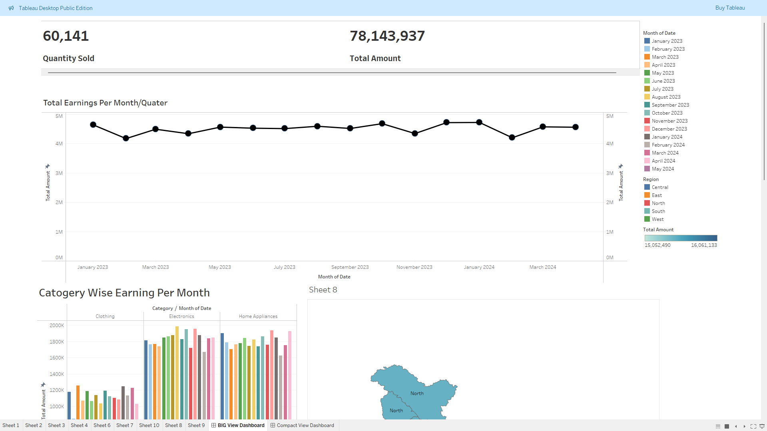
Elements of dashboard
Legend/scale & meaning of color.
Revenue Generated
Total Quantity Sold
Revenue per Month/Time series plot
Slide Bar
You can change the view of dashboard here.

Slide 9
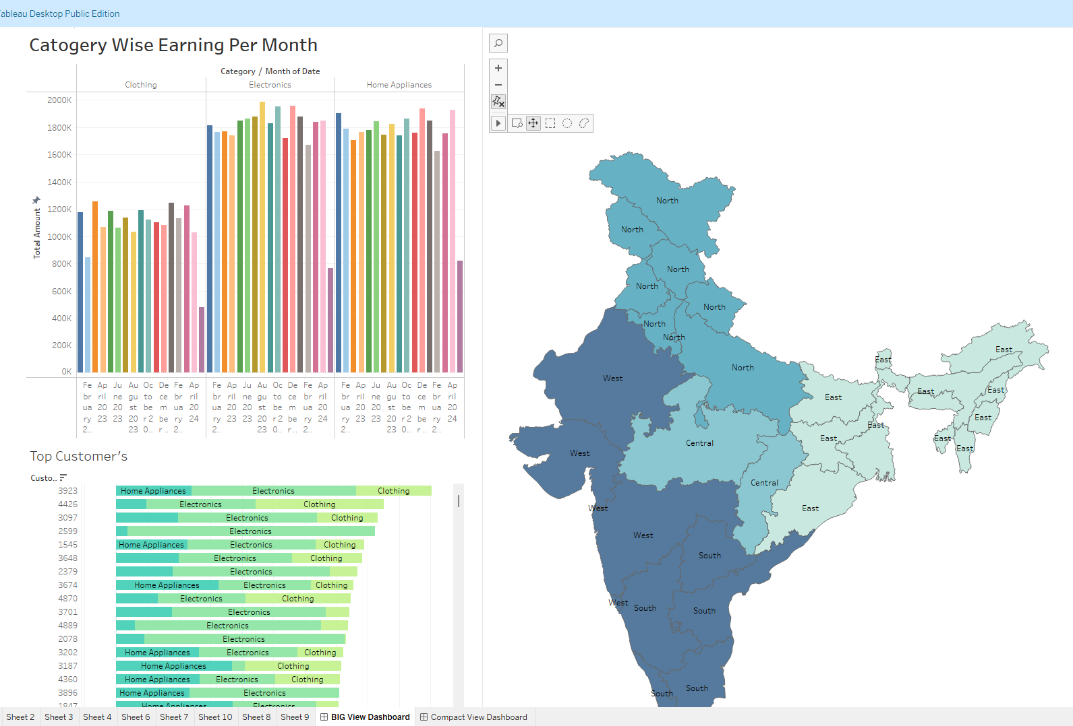
It reset the alignment of map
Category Wise Revenue generated per month
Shows High & Low Revenue as per Region
Top customer by Revenue & Category

Slide 10
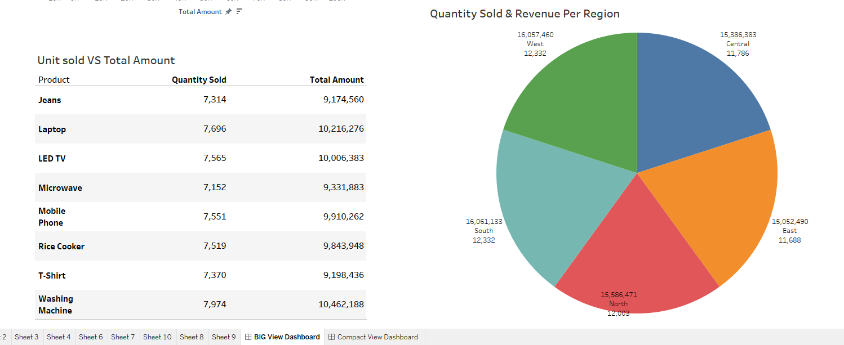
Total Quantity Sold & Revenue generated as per region
You Pivot Table of Quantity VS Revenue as per Product

Slide 11
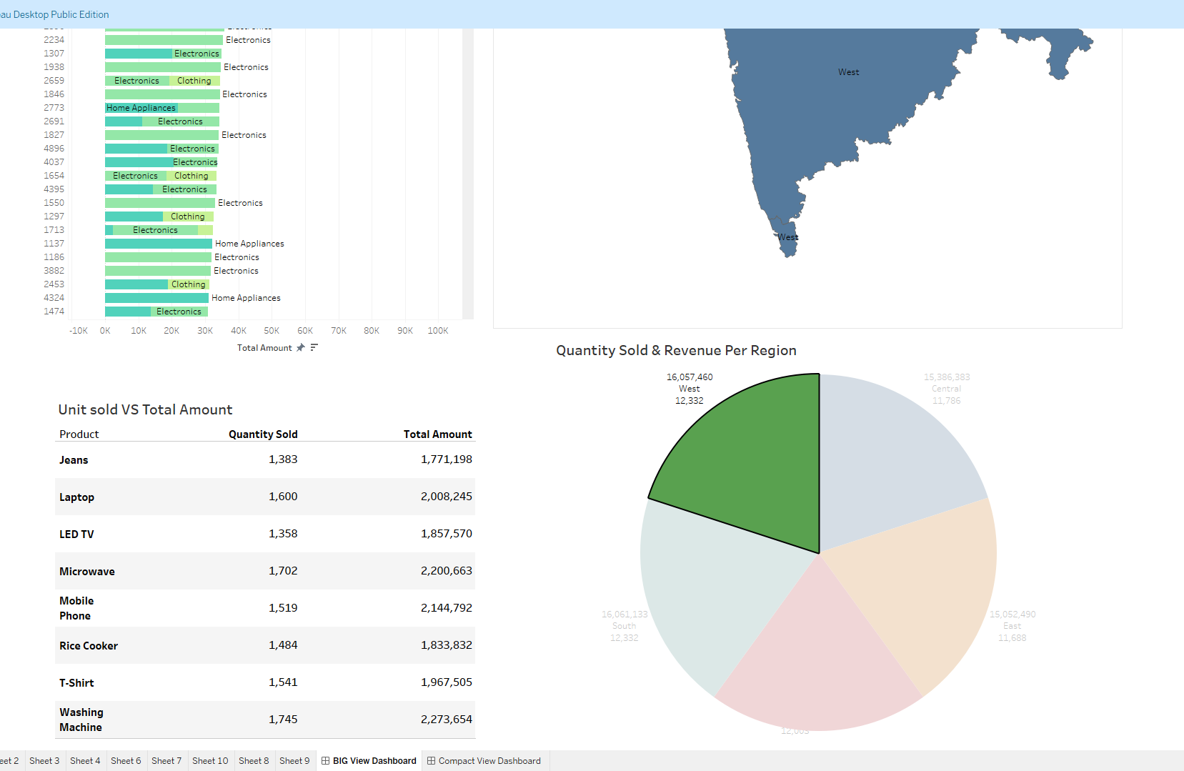
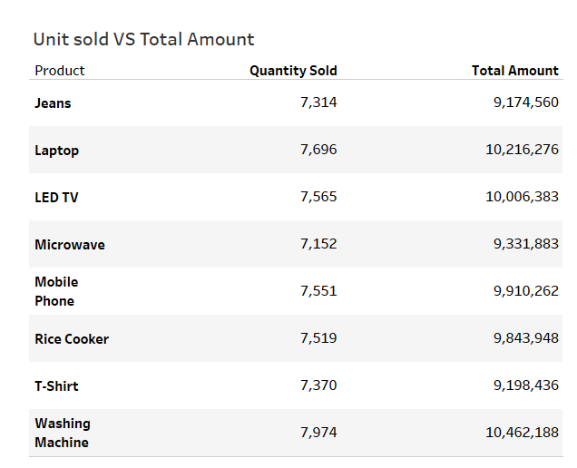
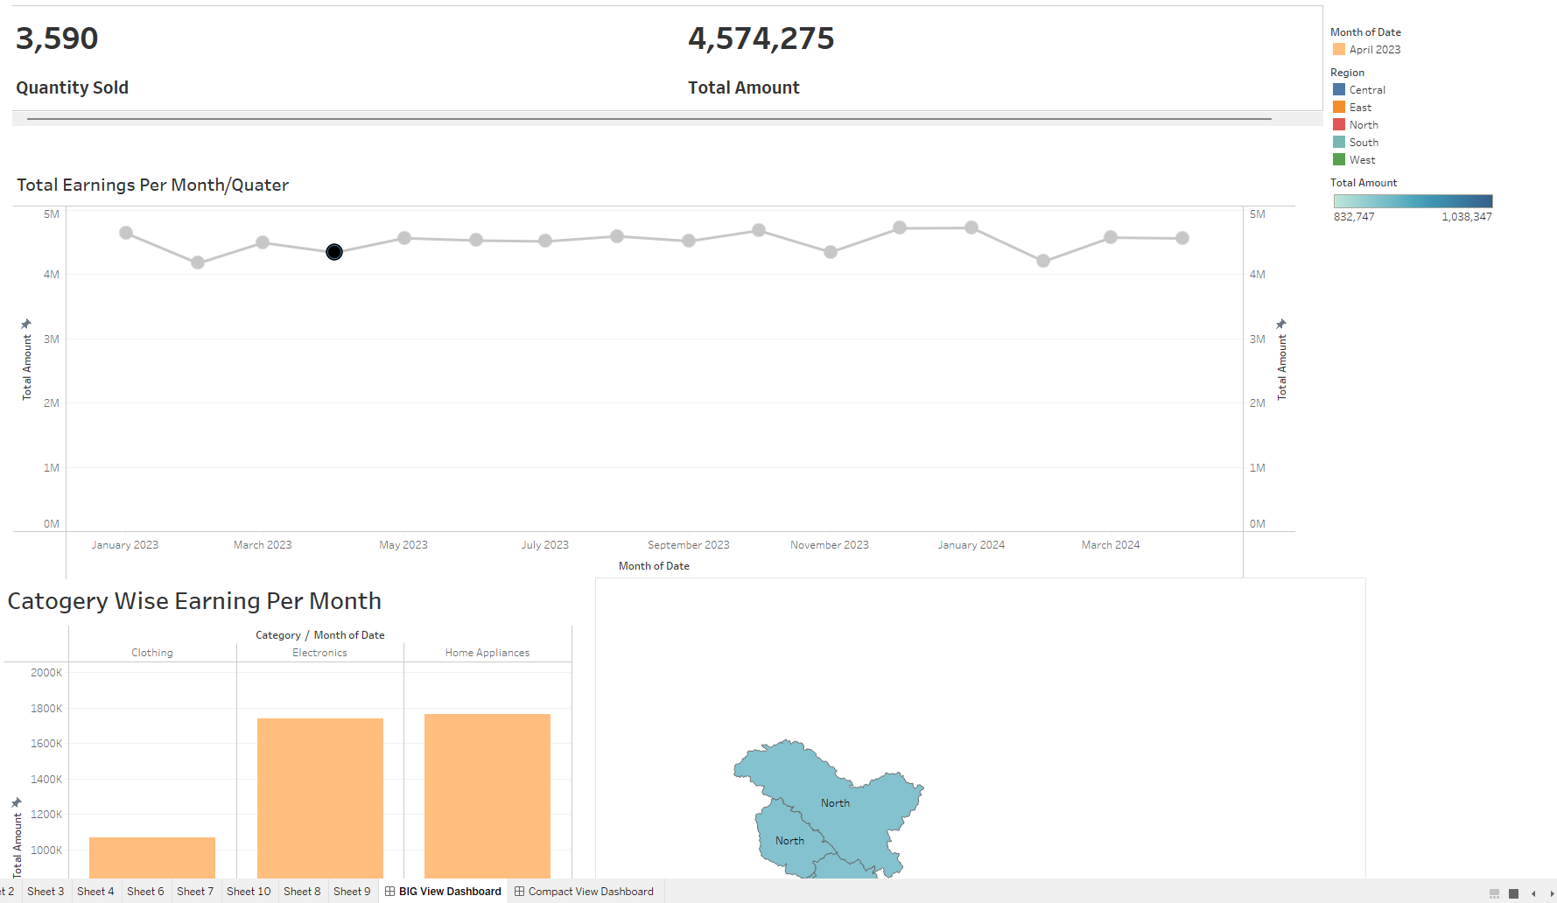
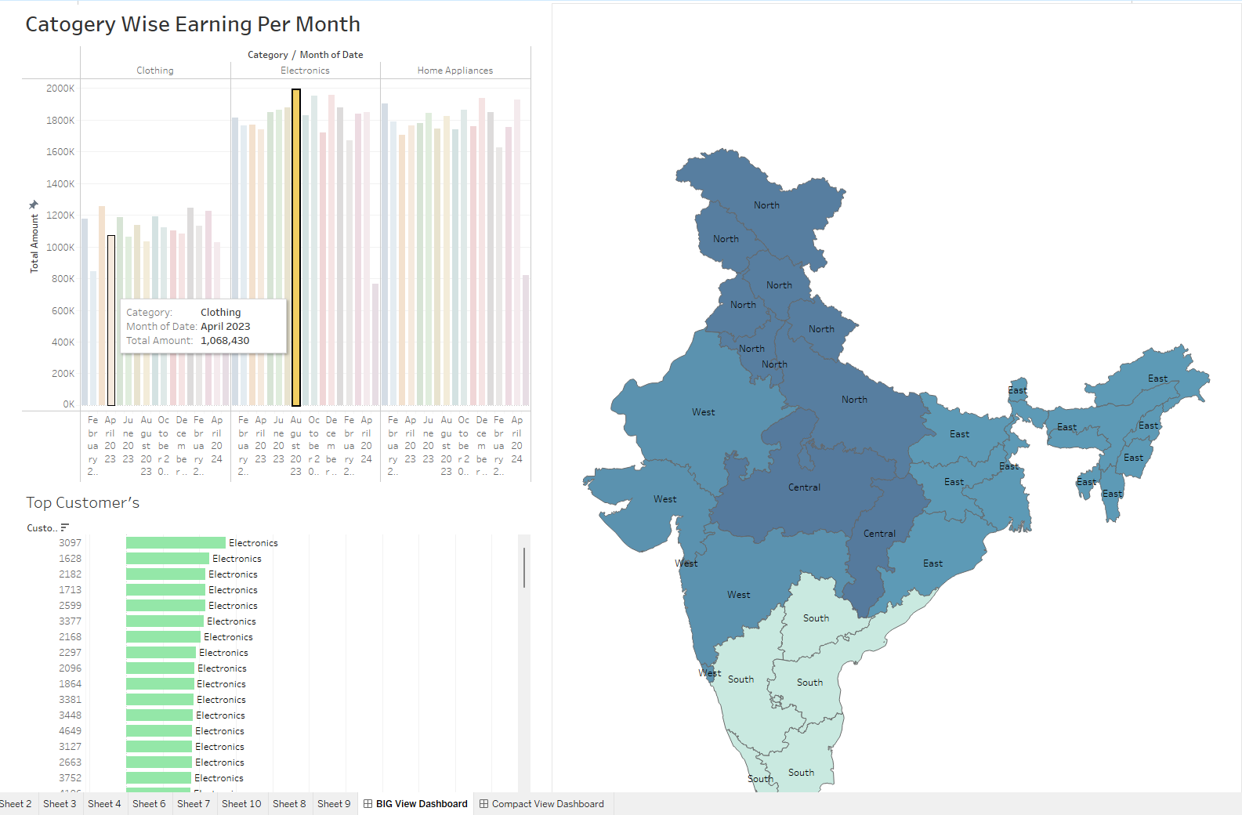
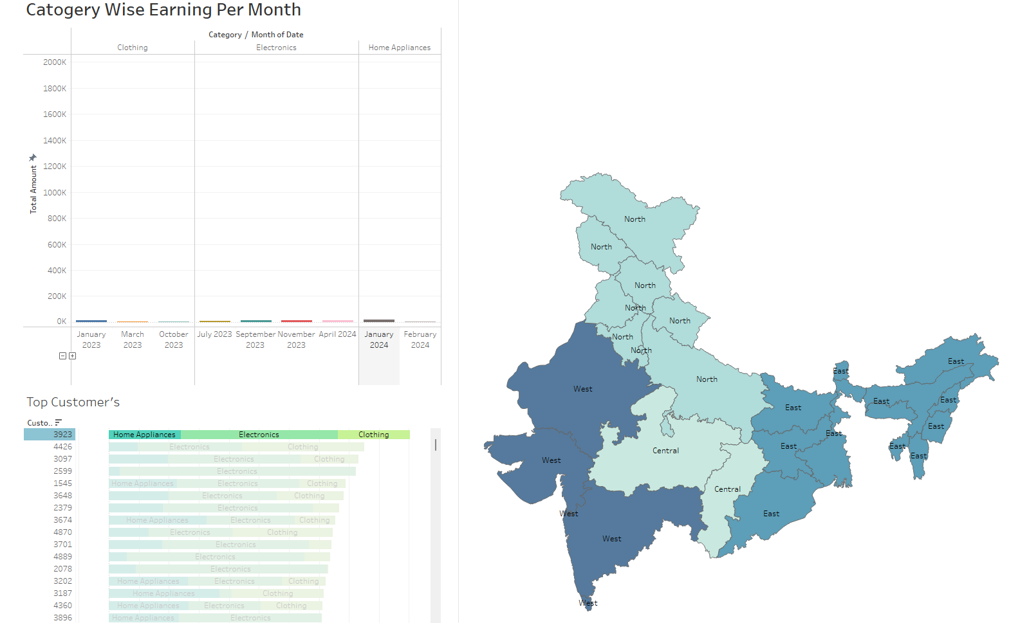
Filters the Visuals according to the Category & Month
Interaction with Tableau Dashboard
We can see customer activity from here.
It will Filter the Visuals according to the Month
Visuals You can Filter According to the Region & see other visuals w.r.t region
You Cannot Interact with the Pivot table , but it will change according to the Filters on other Visuals.

Slide 12
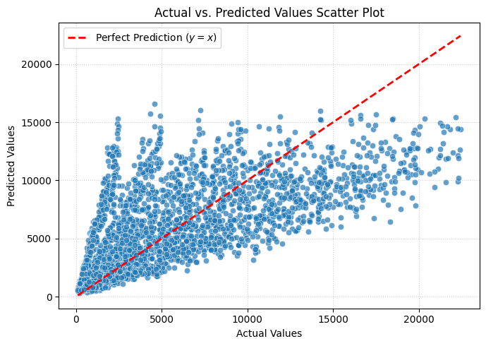
Prediction → Model was trained & tested on test_data.

Slide 13
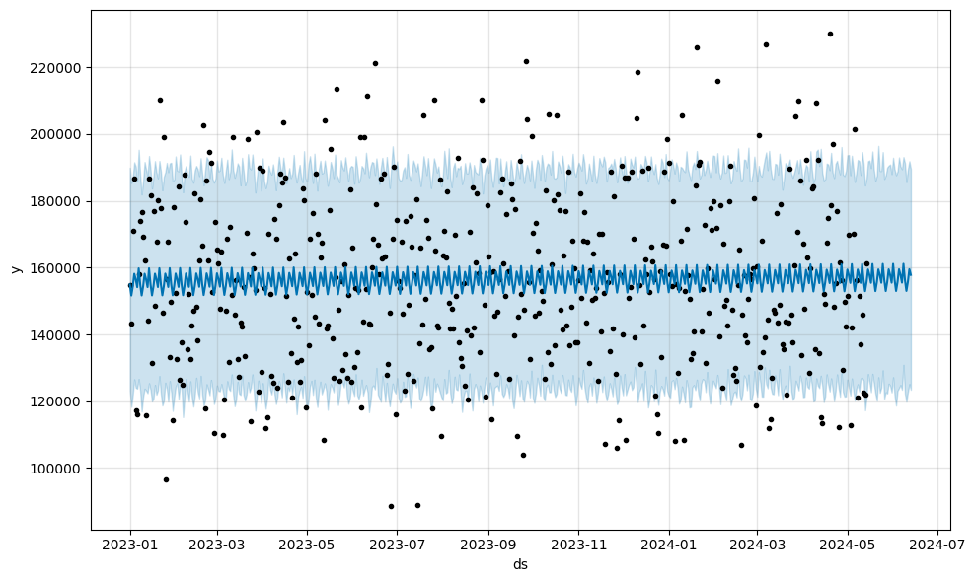
Forecasting using Prophet Model →

Slide 14
End of Slides….

